Slide 1
Projects Overview
Daler Asrorov

Slide 2
Project1: Fanmap
Lots of great music services with millions of users
Great amount of data
Lack of data analysis and mapping = something new to build!
Online international radio stations
LastFM, SoundCloud, Spotify, even YouTube, etc.
How could it be useful?
People around the world could learn about the music tastes of each country
…and they can find out new music
Artists can save their tour budget by going to the countries that like them the most

Slide 3

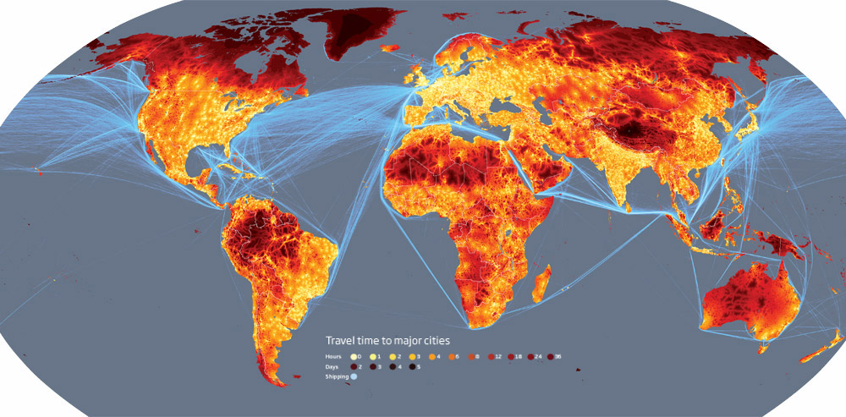
App flow
Radio to Fan

Slide 4
App Flow details: radio Map
Generated Radio Map
Top 3 artists in each country
A point represents a whole country
Data from LastFM Radio (The most popular online radio – over 50 million users)
Event: click on the point
See top 3 artists in a box
Select an artist in a box -> another window with an information about the artist, popular songs, etc.
Fan Map generation link, which directs the user to a different route with a new map that has information about the Fan Map
Possible addition: filter by genre

Slide 5
App Flow Details: Fan Map
Generation of the fan map, which is…
Heat map (?) that depends on the favoritism of a selected artist
It has…
Sentimental analysis
Twitter
Keywords
Number of hits and other numerical data
Likelihood to visit = Sentimental analysis score + points gathered based on place
70 to 30 percent ration (sentimental analysis to points gathered based on place)
See later slides for the details about the points gathered
Cost generation
Where the artist can get more money
Box with real-time social feeds from Twitter about the artist

Slide 6
Good things
Low risk
No critical areas that could impact ESRI or the rest of the world
Useful
Artists can use that as one of their main tools to plan a tour
Fun!
It’s always fun to learn about the world through music
ArcGIS for help!
Using ArcGIS Web API to build the app

Slide 7
Bad things
Sentimental Analysis Error
Ex: a lot of people say bad things about Justin Bieber on social media, but they still may like his songs
Solution:
If an artist is in the top 3 in the country, he will get additional points based on the his place
1st place = 30 points
2nd place = 20 points
3rd place = 10 points
Will kind of normalize the factor of touring in a particular country

Slide 8
Useful Apis & links
- http://www.programmableweb.com/news/50000-radio-stations-one-api/2012/01/26 - radio directory of 50,000+ radio stations from all around the world
- https://developers.arcgis.com/javascript/ - ArcGIS Web API for map generation
- https://dev.twitter.com/overview/documentation - Twitter API for social media analysis
- http://help.sentiment140.com/api - sentiment analysis API of twitter organization or individual
- http://developer.echonest.com/docs/v4/artist.html - biography of artist API
- http://www.last.fm/ - best internet radio that has a great API with geo-data and top artists 50 most listened artists for each country

Slide 9
Tech stack
ArcGIS/Dojo
AngularJS
Jquery
NodeJS
CSS/Bootstrap

